Slide 2
When AL PACINO created S1MØNE
he didn’t know that at
55
also her would have to look for a job

Slide 3
What better way to get back into the game than using an
e-Portfolio
to introduce herself after a life so full of experiences!

Slide 4
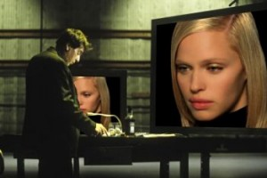
HOW?
This time you will create
…or at least you will give her a LIVED life

Slide 5
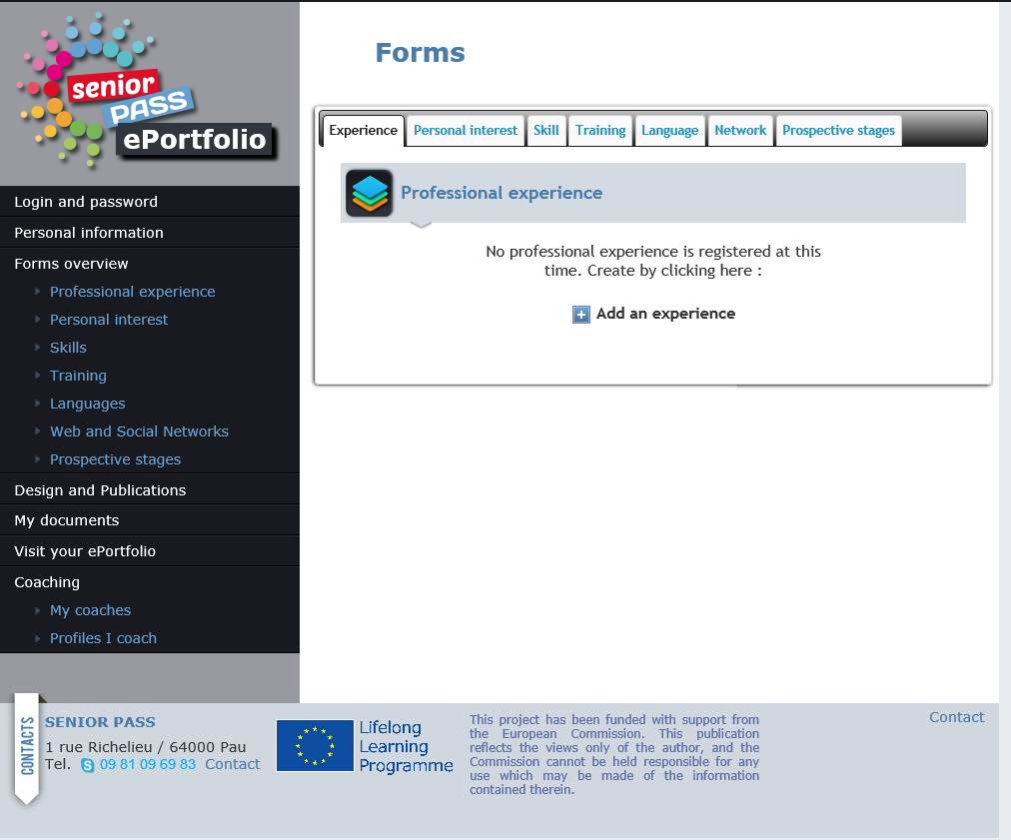
Of course with……
S1MULATIØN ØNE

Slide 6
PHASE 1
WISES
3
Working groups
Maria, Simonetta, Rosa, Maurizio, Elvira, Gisella, Bruno
ENTREPRENEURS
PASSIONALS
Letizia, Pietro, Saverio, Mario, Andrea, Emilio
Fabio, Patrizia, Maria Luisa, Nikola, Francesca, Benedetto, Laura

Slide 7
PHASE 1
WISES
TRAINING
Maria, Simonetta, Rosa, Maurizio, Elvira, Gisella, Bruno
S1MØNE has always paid close attention to her training and in her life she attended classes and participated in training activities, collecting, if applicable, diplomas and certificates of achievements in terms of knowledge.
5
IMAGINE AND DESCRIBE AT LEAST

Slide 8
PHASE 1
ENTREPRENEURS
WORK
Letizia, Pietro, Saverio, Mario, Andrea, Emilio
S1MØNE, apart from a brief period in the film with Al Pacino, she changed several jobs, some important some less, while looking for something more interesting and suitable for her. She did not always got work responsibilities, but her humility has always driven her to be good
5
IMAGINE AND DESCRIBE AT LEAST

Slide 9
PHASE 1
PASSIONALS
PERSONAL INTERESTS
Fabio, Patrizia, Maria Luisa, Nikola, Francesca, Benedetto, Laura
S1MØNE has always had different passions and loved to travel. Some of them have really grown in depth and over the time, such as the sports, others were momentary passions, looking for personal gratification and to remain always up to date and in line with
the times
5
IMAGINE AND DESCRIBE AT LEAST

Slide 10
PHASE 1
Made 3 copies
15’
YOU HAVE

Slide 11
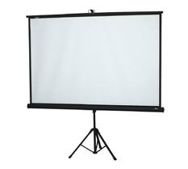
PHASE 2
Remember that in the E-Portfolio you can insert ..

Slide 12
FASE 2
WISES
TRAINING
Maria, Simonetta, Rosa, Maurizio, Elvira, Gisella, Bruno
In her library, into the archives, S1MØNE has kept all her diplomas, certificates and also photos of the groups with which she had training activities, she also has some small short videos that show them at work ......
5
PRODUCE OR FIND AT LEAST

Slide 13
PHASE 2
ENTRENEURS
WORK
Letizia, Pietro, Saverio, Mario, Andrea, Emilio
S1MØNE sometimes also received letters of reference from her previous employer that she held in her library and on her pc, some of the work done or pictures of the products she worked on, and some short videos of public events to launch what she accomplished with colleagues
5
PRODUCE OR FIND AT LEAST

Slide 14
PHASE 2
PASSIONALS
PERSONAL INTERESTS
Fabio, Patrizia, Maria Luisa, Nikola, Francesca, Benedetto, Laura
S1MØNE loves photographs and keeps all the postcards of the places she visited, and also filmed some video stored on her computer along with those of competitive sport that she faced
5
PRODUCE OR FIND AT LEAST

Slide 15
PHASE 2
Made 3 copies
20’
YOU HAVE

Slide 16
PHASE 3
WHAT AND HOW MANY ARE HER SKILLS?
20’

Slide 17
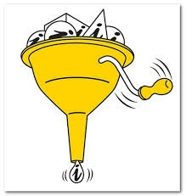
PHASE 4
20’

Slide 19
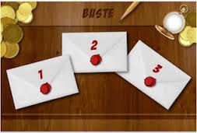
PHASE 5
WHAT and WHY to SHOW?
10’

Slide 20
WHAT HAS CHANGED?

Slide 21
and
THANK YOU

Slide 22
... BY THE WAY?!

Slide 23
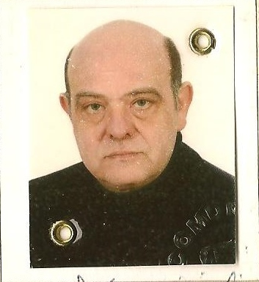
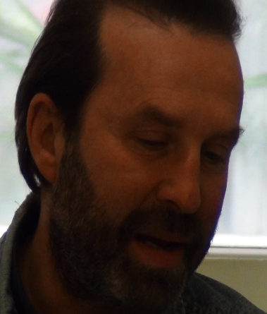
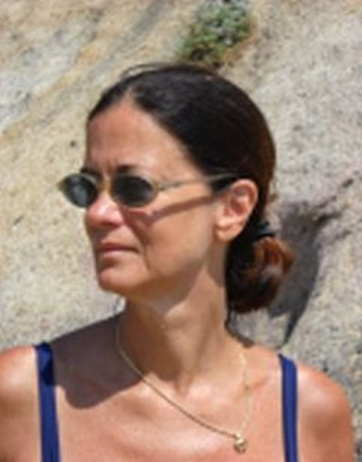
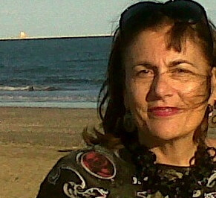
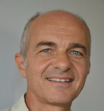
and the Senior Pass adventure continues... …
OR EVERYONE

